Slide 1
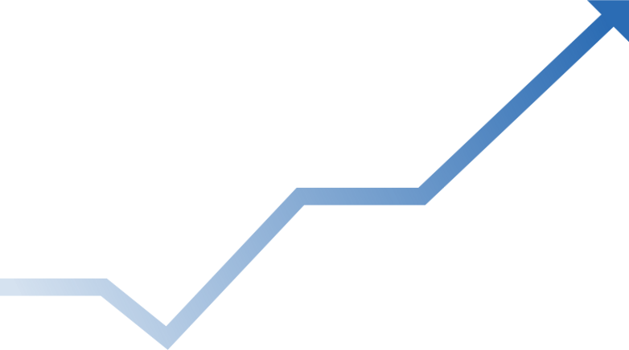



InvestWise :
Intelligent Stock Market Analysis Tool
www.investwise.com

Slide 2
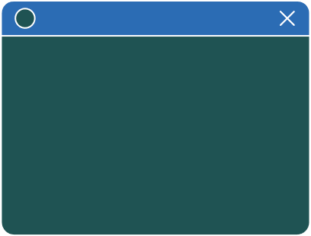

InvestWise
Intelligent Stock Price Prediction & Sentiment Analysis Web App
Presented by:
Supervised by :
Vijay Kumar Trivedi
Deepali Kumari - 24BCE11526
MAYANK JOSHI 24BCE10858
SWAPNIL SONI 24BCE10071 SAKSHAM AGARWAL 24BCE10432
KAYUR SHARMA 24BCE10869

Slide 3
Existing Work & Limitations
Challenge: Traditional methods struggle with the market's complexity.
Technical Analysis (e.g., Moving Averages, RSI):
Limitation: Often uses lagging indicators, reacting to past events rather than predicting future ones. They can fail to capture the sudden impact of breaking news.
Fundamental Analysis:
Limitation: Involves manual, time-consuming analysis of financial statements. It does not account for real-time market sentiment or short-term volatility.
Basic Algorithmic Models:
Limitation: Simpler models often miss non-linear, hidden patterns in time-series data and cannot effectively process unstructured data like news headlines.
Our project addresses these gaps by integrating both time-series data and real-time sentiment.

Slide 4
Novelty of the Project
What makes InvestWise unique?
Our project's novelty lies in the synergistic integration of two distinct AI approaches into a single, intuitive platform.
Quantitative Prediction: We use a powerful LSTM model to analyze complex, long-term patterns in historical price data, something simpler models cannot do effectively.
Qualitative Sentiment Analysis: We simultaneously capture the real-time market mood by applying Natural Language Processing (NLP) to live financial news.
Unified Platform: Unlike other tools that focus on either technical charting or news aggregation, InvestWise provides a holistic view by combining price prediction with actionable sentiment insights (Bullish, Bearish, Neutral)

Slide 5
Implementation & Coding
From Code to Prediction
Our implementation connects a Python backend with a user-friendly frontend.
Backend (Flask): A Flask server handles user requests.
It calls the yfinance library to fetch 120 days of historical data for a givenstock ticker.
It uses a pre-trained Keras/TensorFlow LSTM model (.keras file) to process the data and generate a prediction.
Frontend (HTML/JS): The predicted price and sentiment score are sent to the frontend and displayed to the user using JavaScript and Chart.js

Slide 6

Why Predicting Stocks is Hard
Stock prices fluctuate due to a complex interplay of news, global events, company performance, and human emotion. Traditional analytical methods often fail to capture these hidden, dynamic patterns.
Hidden Patterns
Traditional methods often miss subtle, non-obvious correlations.
Market Dynamics
Influenced by news, global events, and corporate performance.
Emotional Impact
Human sentiment and biases drive significant price swings.

Slide 7
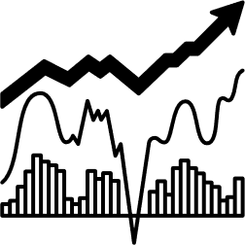

Problem: Stock prices are highly volatile and influenced by numerous factors, making accurate prediction a challenging task.
Objective: To develop a Machine Learning model that can analyze historical stock price data and predict future closing prices with a high degree of accuracy.
Goal: To create a tool that can aid investors in making more informed decisions.
This model works on the combination of sentimental analysis and data analysis

Slide 8



Source: Yahoo Finance (using the yfinance library).
Time Period: Data was fetched for a specific historical range
(e.g., 2015-2023).
Features Used:
Open: Opening price of the stock
High: Highest price of the day
Low: Lowest price of the day
Close: Closing price of the day (Target Variable)
Volume: Trading volume

Slide 9
LSTM: Our Core Predictive Engine
We chose Long Short-Term Memory (LSTM) networks because they are uniquely suited for time-series data like stock prices.
Time-Series Mastery
Long-Term Memory
Volatility Resilience
LSTM is a deep learning model specifically designed for sequential data.
Long-Term Memory
Unlike simpler models, LSTMs can retain information over extended periods, capturing complex market trends.
It effectively handles the non-linear and volatile nature of financial markets.

Slide 10

"LSTM: OUR CORE PREDICTIVE ENGINE"
Model Architecture
Sequential: This is the foundational Keras model, representing a linear stack of
layers. Our model is built step-by-step in this sequence.
LSTM: This is the core layer of our model, specifically chosen for its ability to remember information over long periods, making it ideal for analyzing historical stock price data.
Dense: This is a fully connected neural network layer that takes the learnings from the LSTM layers to compute the final output—the predicted stock price.
Dropout: This is a regularization technique used during training. It randomly deactivates a fraction of neurons to prevent the model from becoming too specialized to the training data (overfitting), which improves its prediction accuracy on new, unseen data.

Slide 11


The Power of News Sentiment
Market psychology drives significant price movements. We capture this through real-time news sentiment analysis.
Live Headlines
Fetch real-time financial news from top sources.
NLP with TextBlob
Utilise Natural Language Processing to analyse the emotional tone of news.
Sentiment Classification
Classify market mood as Bullish, Bearish, or Neutral, providing actionable insights

Slide 12
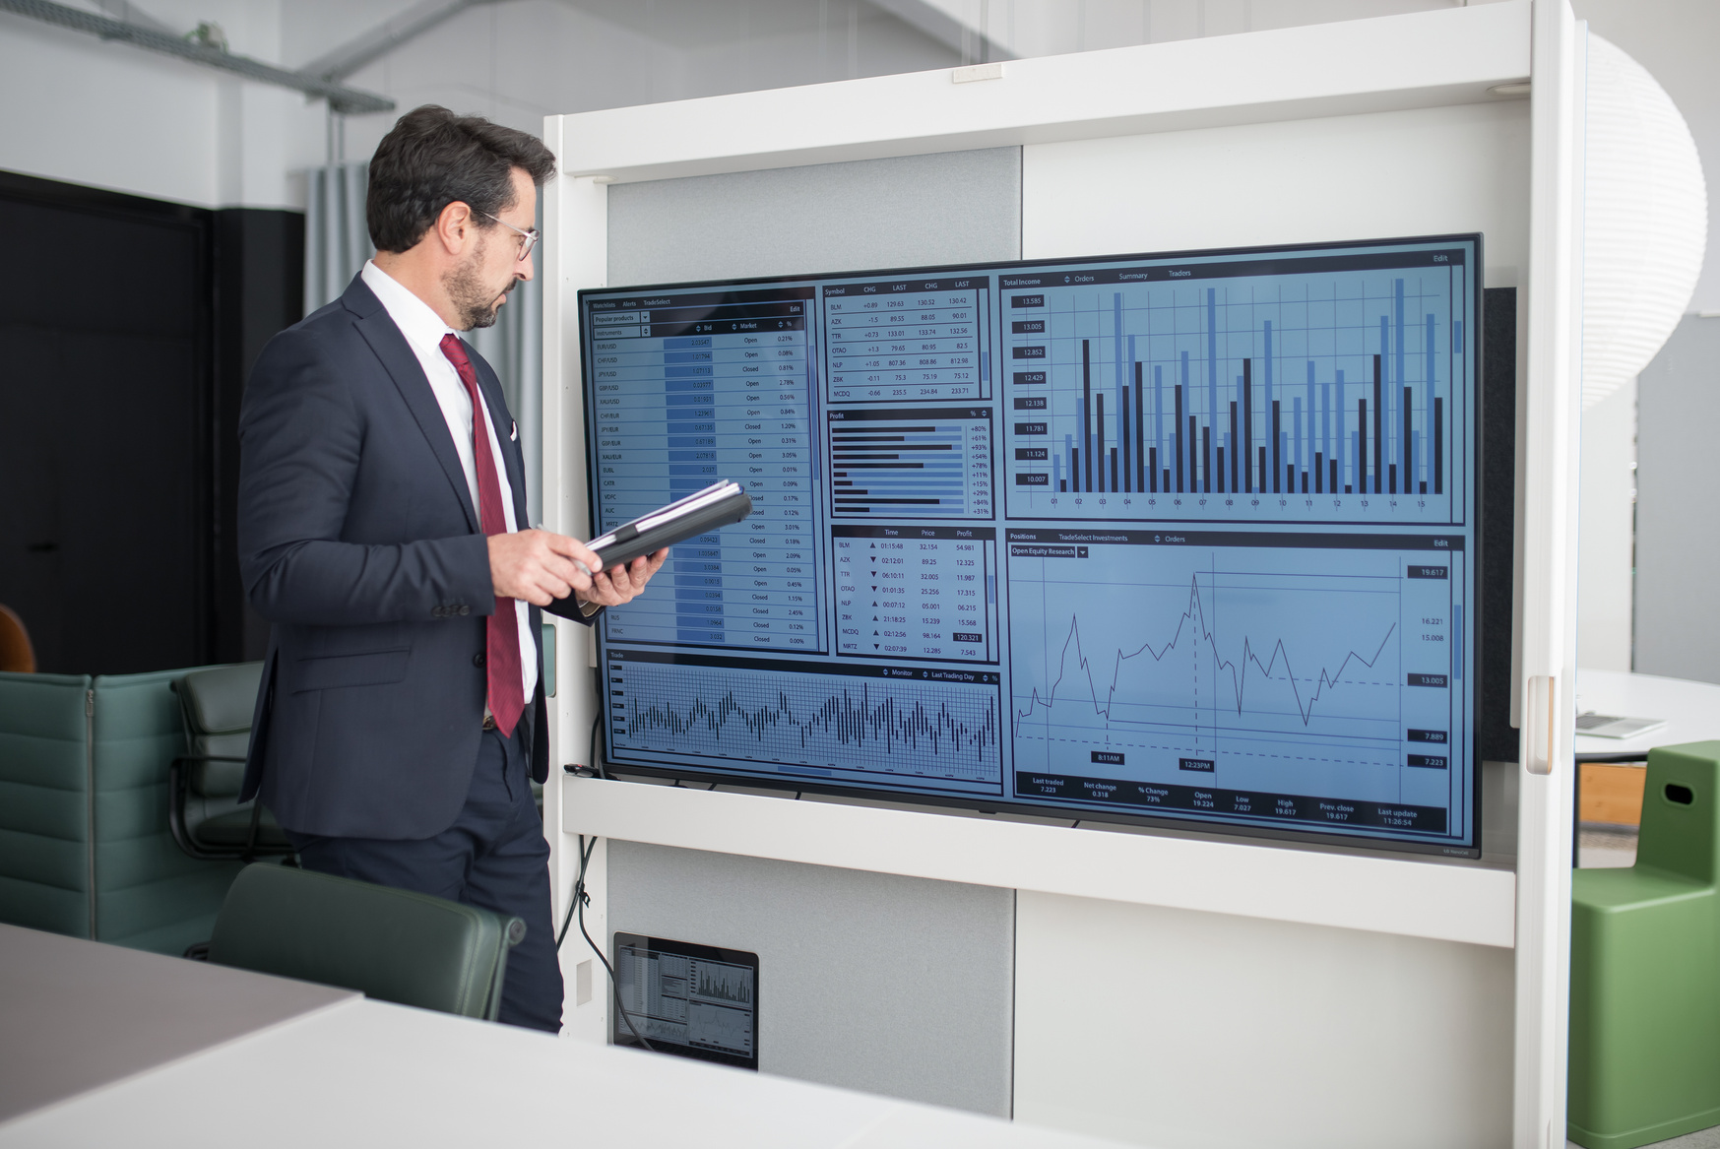
Solving Key Investor Challenges
Retail investors often struggle with market complexity. InvestWise addresses three critical gaps:
Complex Pattern Analysis
Difficulty in discerning intricate price trends.
Real-Time Market Mood
Lack of immediate insight into market sentiment.
Integrated Tooling
Absence of a single platform for both prediction and sentiment.

Slide 13

The InvestWise Platform
Our web application empowers users with comprehensive, intuitive financial insights
Price Prediction
LSTM predicts the next day's opening price.
Sentiment Analysis
NLP evaluates live news sentiment.
Live Data & Charts
Fetches real-time stock and crypto prices with interactive historical charts.
Intuitive UI
Simple, clean interface designed for all users.

Slide 14
System Architecture
Frontend
HTML, CSS, JS. User inputs ticker, views predictions & charts.
Backend
Flask + Python logic. Handles API calls, model execution.
Data & Models
yfinance, NewsAPI, CoinGecko, Pre-trained LSTM (.keras).

Slide 15
Our Robust Technology Stack
Category | Technologies/Tools
Backend | Python, Flask
Machine Learning | TensorFlow, Keras
Data Handling | Pandas, NumPy
Sentiment Analysis | TextBlob, NewsAPI
Crypto Data | CoinGecko
Frontend | HTML, CSS, JS, Chart.js
Version Control | Git + GitHub

Slide 16
Prediction & Sentiment Flow
Prediction Flow
Sentiment Flow
Fetch 120 days of historical data from yfinance.
Normalize data for model input.
Feed normalized data into the LSTM model.
Receive the predicted next day's open price.
Inverse scale the prediction to original values.
Fetch live financial news articles via NewsAPI.
Process text through TextBlob for polarity scoring.
Generate a sentiment label (Bullish, Bearish, Neutral) based on the score.

Slide 17
Timeline and workplan
 | Phase | Description
1. | Planning | Research & Tech Selection
2. | Backened | Train LSTM , Setup Flask
3. | Core Features | Add yfinance, model integration
4. | Sentiment | NewsAPI + TextBlob
5. | Frontened | HTML , JS , Chart.js
6. | Testing | Debug, deploy, finalize

Slide 18
hardware & software used
HARDWARE
laptop with 8+ gb ram
SOFTWARE TOOLS
os : windows
ide : vs code
python 3.8+
browser for testing
git for versioning

Slide 19
libraries, apis & data sources
Libraries :
Flask , Keras , TensorFlow , Scikit-learn, Pandas , Numpy
APIs:
yfinance ⟶ Stock Data
NewsAPI ⟶ Headlines
CoinGecko ⟶ Crypto prices
Data ⟶ Yahoo Finance historical stock data

Slide 20
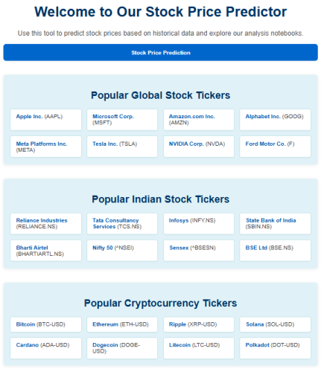
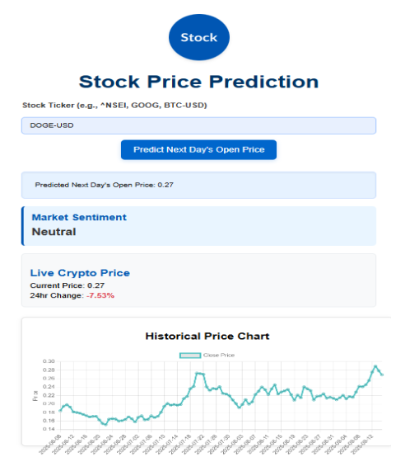
Snapshots of the Project

Slide 21

Hyperlink:-
The following resources were consulted for research and understanding the underlying technologies and data for this project
https://machinelearningmastery.com/start-here/#getstarted
https://colah.github.io/posts/2015-08-Understanding-LSTMs/
https://www.sas.com/en_us/insights/analytics/machine-learning.html
https://groww.in/us-stocks/googl
https://www.investopedia.com/terms/d/deep-learning.asp
https://www.nasdaq.com/market-activity/stocks/goog

Slide 22


Github Repository link :-
https://github.com/Mayank251125/Stock_Market_Analysis_Tool
Video Demonstration link :-
https://drive.google.com/file/d/1Hg1ZxplE20vCEb0p8oXF31_iKRYuH7f1/view?usp=sharing

Slide 23
Conclusion
We successfully developed InvestWise, a web-based tool that addresses the challenge of stock market volatility.
By integrating a deep learning LSTM model with real-time NLP-based sentiment analysis, our platform provides investors with a powerful tool for making more informed decisions.
The project has met its objective of creating a high-accuracy predictive model within a user-friendly interface.
Future Scope
Expand Model Portfolio: Incorporate other predictive models (e.g., ARIMA, GARCH) to offer users comparative analysis.
Increase Data Sources: Integrate more news sources and social media feeds for a richer sentiment analysis.
Enhanced Features: Add features like portfolio management, risk assessment, and automated trading alerts.

Slide 24

Thank You !

